Slide 1
Mid-project review Wordio Kayleigh Soane

Slide 2
Wordio
Translation tool
New to coding, wanted to challenge myself but not overwhelm myself
Was suggested it, had a lot of ideas for it
Was looking forward to designing the UI
Useful tool that many people use daily

Slide 3
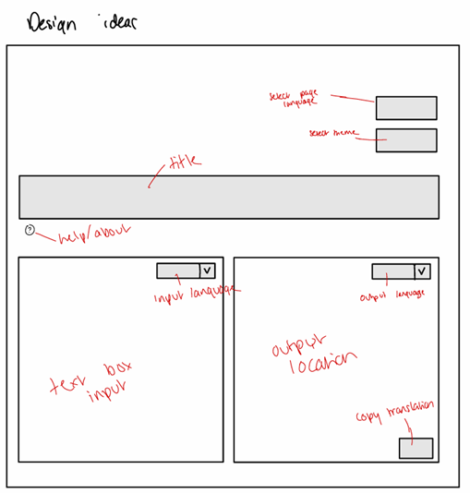
Project plan
Project communication sessions
Have text input, output and language selectors
Accessibility features
About button, github link
Morse code translation
Copy, text to speech, swap buttons not coded yet
Translation API not yet implemented
Project communication sessions
Advised to focus on UI
Gantt chart and sprint creation

Slide 4
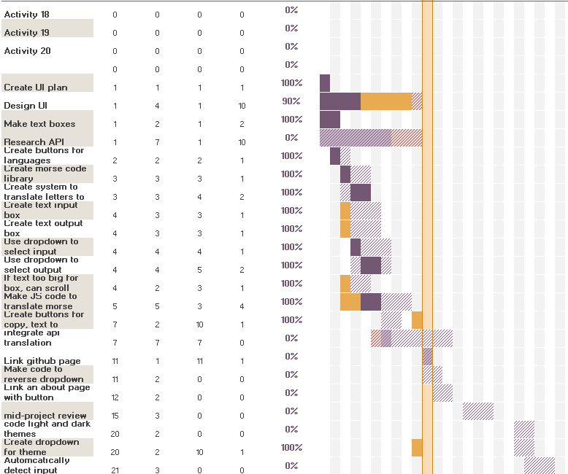
Gantt chart

Slide 5
Initial UML models

Slide 6
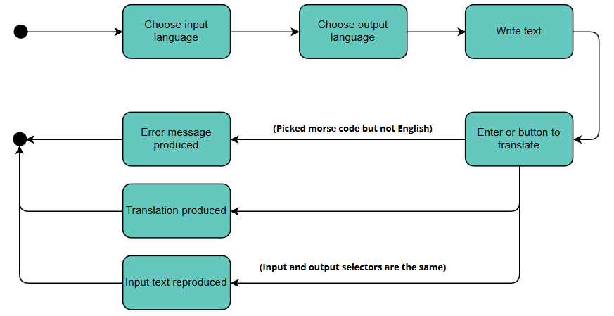

Slide 7
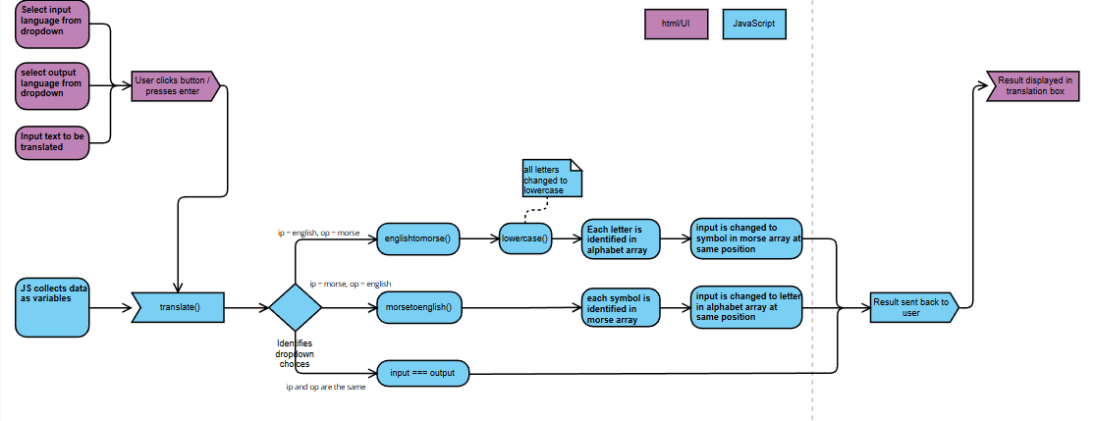
User interaction/case scenarios
Sitemap
Behavioral diagram – interaction between elements

Slide 8
Initial prototype

Slide 9
Challenges
New to html, css, js. Never used it outside of tutorials in lab sessions earlier this year
Making morse code translation helped build beginning js skills
Didn’t know JS language so had to do lots if research on how to write the code
Followed guides to learn how to add more modern features to UI
Biggest challenge is the API

Slide 10
Thank you

